Slide 1
Changes to support inter-scheme payments in Mojaloop

Slide 2
Objective
To define the scope the changes required in order for Mojaloop to support inter-scheme or intra-scheme payments without requiring DFSPs to know which type of payment is being made.
Definition of an inter-scheme payment:
A payment where the debtor DFSP and the creditor DFSP are in different schemes.
It should not be a requirement that both schemes are Mojaloop schemes, although we assume for examples that they are.
This will have consequences, which need analysis, for the entry requirements we would place on non-Mojaloop schemes joining a Mojaloop interscheme.
An inter-scheme payment may or may not require currency conversion.

Slide 3
Definition and assumptions
An inter-scheme payment is:
A payment where the debtor DFSP and the creditor DFSP belongs to different schemes.
Both schemes may or may not be Mojaloop schemes but it is not a requirement
Note: in this presentation, we assume that both schemes are Mojaloop.
A non-Mojaloop scheme will have entry requirements to join a Mojaloop interscheme that need to be analyzed more in details.
An inter-scheme payment may or may not require currency conversion.

Slide 4
Assumptions
DFSPs in linked schemes have identifiers which are unique across all linked schemes.

Slide 5
Characteristics of a proxy
A registered participant in two schemes.
Can use the same messaging structure on both sides. If it does:
No format conversion.
Non-repudiation signatures are valid on both sides.
A multi-scheme ecosystem can accommodate both types of proxy.
Format conversion is intra-proxy behaviour: no other participant needs to know about it.
Maintains ledgers in both the schemes to which it is attached.
This analysis excludes questions of settlement, which (I think) are not relevant to it.
What does a proxy do?
Receives a message from a switch in the source scheme
Assumes time-out responsibilities where appropriate
Registers its participation in the payment chain
Performs the non-repudiation check
(Perhaps)
Converts the message content.
Re-signs the message: now it comes from the proxy, not the originator.
Sends the message to the switch in the target scheme.
Cancels time-out responsibilities where appropriate.

Slide 6
Point 1: Register proxies at switch
A data structure which enables a scheme to register a proxy.
One data element:
The name of the proxy in the scheme where the information is stored (an FspId).
Assume that setting this up in configuration is sufficient for now.

Slide 7
Typical scenario we are looking to address
RegionalScheme (multi-currency)
Proxy
ProxyA
ProxyB
Switch C
FXP 1
Proxy A
Proxy B
MalawiScheme (MWK)
Scenario:
DFSP 1 sends 1000 MWK to DFSP 2
DFSP 2 receives 20 ZMW
Currency conversion is done in the regional scheme.
ZambiaScheme (ZMW)
Switch A
Switch B
Proxy
ProxyA
Proxy
ProxyB
DFSP 1 (Debtor)
DFSP 2 (Creditor)

Slide 9
Requirements for an interscheme payments
Domestic
International
Address resolution
Routing
Time out
Settlement/Liquidity
FX
Sanction

Slide 10
Associating DFSPs with proxies

Slide 11
Associating DFSPs with Proxies (1)
A DFSP will either be local to the scheme or remote ie accessible via a proxy.
The definition of a local DFSP is: has an entry in the Participant dataset without a PROXY attribute.
We will extend the Participant dataset to include the IP address of a DFSP.
When a proxy forwards a message, it will add its registered IP address to the content of the X-Forwarded-For parameter in the header.
A remote DFSP will be accessible via an association with a proxy.
We will store an association between a DFSP and a proxy. Note that this will be an on-demand association, not a pre-loaded association
Assertion: an association between a DFSP and a proxy will always have been made before access to the DFSP is required.
We test this assertion later

Slide 12
Associating DFSPs with Proxies (2)
When a switch receives a message from a proxy, it checks the list of associations to see if the originator of the message (as defined by the last entry in the X-Forwarded-For parameter in the header) is registered against the proxy which was the immediate source of the message.
If it isn’t registered, the switch stores the association for future use.

Slide 13
Non-repudiation

Slide 14
Point 3: non-repudiation
The non-repudiation signature covers the originating and destination DFSPs
In the FSPIOP-Source and FSPIOP-Destination parameters in the header.
We’ve so far failed to grasp the nettle of signatures over parts of the message.
So we’d like to avoid this if possible.

Slide 15
Re-routing messages

Slide 16
Re-routing messages
When a switch comes to forward a message:
If the FSPIOP-Destination parameter refers to a DFSP in the switch’s scheme, it forwards the message there.
Otherwise, it looks up the proxy which stands for the DFSP and forwards the message there.
This means: to the entry in the participant end-point dataset for the Proxy and the original endpoint type.
If there is no proxy for the DFSP (circumstances TBD), then it searches the network of proxies for the DFSP.
If not found, error.
Every DFSP for which a GET /parties has been called will have an association with a proxy.
No changes to the non-repudiation signature are required.

Slide 17
Searching across schemes

Slide 18
Searching across schemes
If a DFSP asks for a set of FXPs via the GET /services/FXP endpoint, that search should be across the whole ecosystem.
Switches should map the FXPs returned from proxies against the proxy for later use.
This is also a fall-back function if a switch does not have a proxy mapping for a DFSP which is not one of its participants.
This may be true for other searches as well:
For instance, we might want allow a PISP to act for a customer of any DFSP in a multi-scheme ecosystem.

Slide 19
A DFSP look-up function
This story needs to address two use cases:
The ID of the destination DFSP is known, but it is not a member of the local scheme (as tested by: does its FSP ID appear in the list of local participants?) and there is no proxy association for it.
The ID of the destination DFSP is not known, but the DFSP is known not to be a member of the local scheme (e.g. it is an address resolution call and the appropriate oracle has returned a NOT FOUND).

Slide 20
Characteristics of the function (1)
When a message is received from a DFSP:
If the URI/FSP ID combination is not already the subject of a search, store:
The URI of the message.
The FSP ID of the eventual recipient of the message, if it is known.
Obtain a list of all the proxies attached to the scheme.
Forward a copy of the message received to all proxies in the list.
If the message was received from a proxy, do not send the message to that proxy.
If the number of messages sent was non-zero, store the number of messages sent against the URI/FSP ID entry.
If the number of messages sent was zero, return an error 3201: Destination FSP Error.

Slide 21
Characteristics of the function (2)
When a message is received from a proxy :
Search the list of searches for:
Either a search with the DFSP and URI returned via the proxy.
Or a search with a blank DFSP and the URI returned via the proxy.
If neither is found:
End.
Decrement the counter created when the search was initiated.
If the message returned is a 3201 error (DFSP not found):
If the counter is now zero:
Forward the message to the next destination.
Remove the search from the list of searches.
End.
Otherwise (DFSP was found):
Forward the message to the next destination.
End.

Slide 22
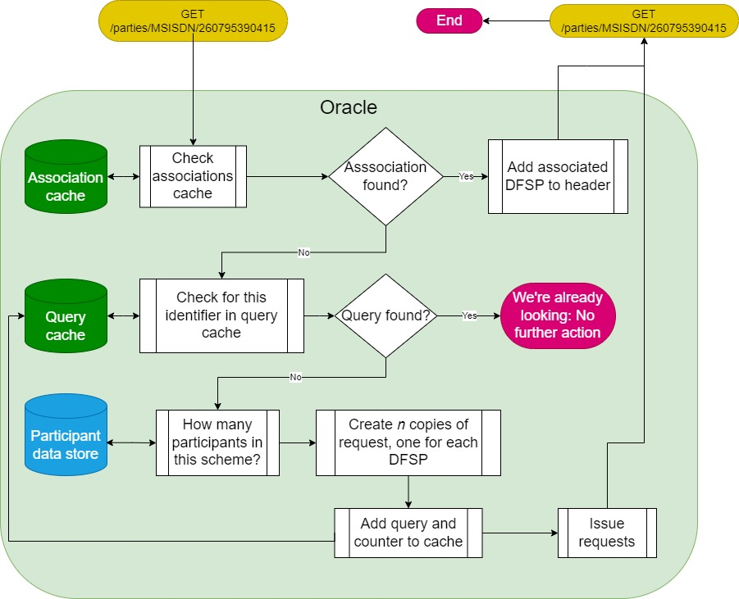
On-demand Address Resolution: GET /parties

Slide 23
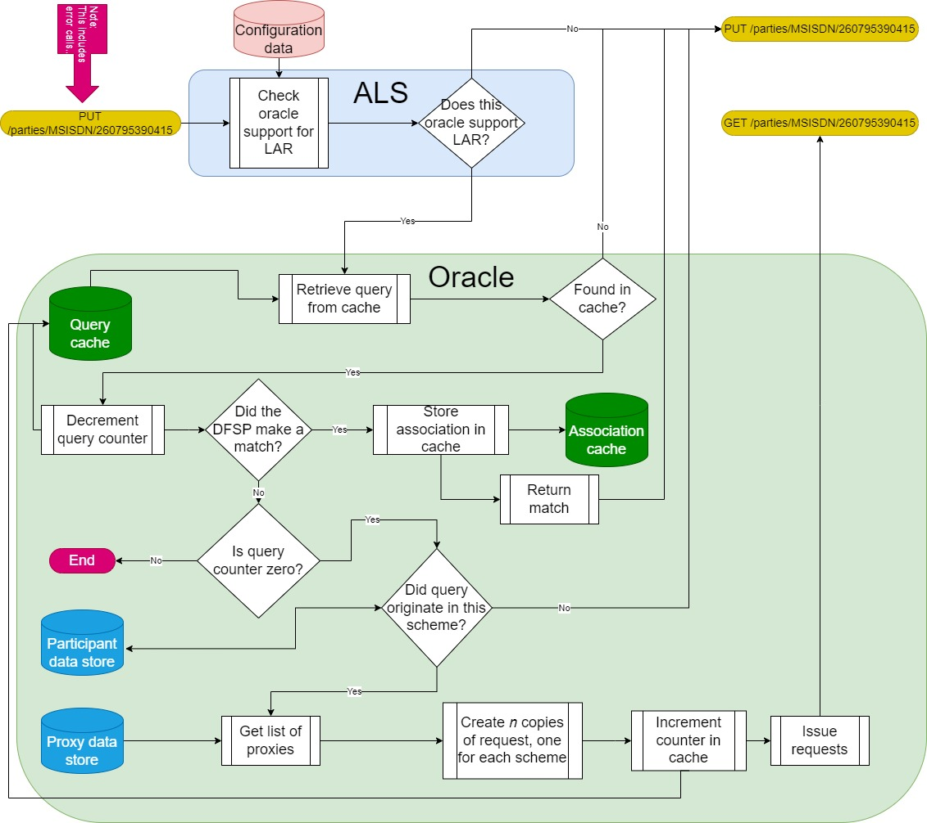
On-demand Address Resolution: PUT /parties

Slide 24
Time-out management

Slide 25
Background
We need to distinguish between two landscapes:
Before the creditor DFSP has confirmed their acceptance of the payment.
After the creditor DFSP has confirmed their acceptance of the payment.
Before acceptance:
We need to support time-outs at the last current point in the chain of messages.
When this point moves, the time-out evaluation point moves with it.
After acceptance:
The payment is irrevocable.
If messages are held up, they are retried until they get through.

Slide 26
The rule is:
When a switch receives a transfer execution request, it should implement time-out checking until it has forwarded the request to a proxy and received a 202 response from the proxy. On receipt of the 202 response, it should turn time-out checking off.
When a proxy receives a transfer execution request, it should implement time-out checking until it has forwarded the request to a switch and received a 202 response from the switch. On receipt of the 202 response, it should turn time-out checking off.

Slide 27
Topology
Debtor DFSP
Creditor DFSP
Proxy 1
Proxy 2
Scheme 1
Scheme 2
Scheme 3

Slide 28
Example
A customer of the debtor DFSP wants to send 1000 KES to a customer of the creditor DFSP.
We exclude currency conversion, which is not relevant to the mechanics of the example.

Slide 29
Payment execution: prepare
Debtor DFSP
Creditor DFSP
POST /transfers
POST /transfers
POST /transfers
Proxy 1
POST /transfers
Proxy 2
POST /transfers
POST /transfers
202: Received
202: Received
Scheme 1
Active timeout check
Scheme 2
Active timeout check
Scheme 3
Reserve 100 KES against D-DFSP’s position account
Reserve 100 KES against Proxy 1’s position account
Reserve 100 KES against Proxy 2’s position account
Forward request to Proxy 1
Forward request to Proxy 2
Forward request to C-DFSP
Active timeout check
Active timeout check
Active timeout check
Turn off timeout check
Turn off timeout check
202: Received
202: Received

Slide 30
What happens if?

Slide 31
Debtor DFSP can’t reach its switch?
Debtor DFSP
Creditor DFSP
Proxy 1
Proxy 2
Scheme 1
Scheme 2
Scheme 3
Nothing:
The debtor DFSP times out and returns its customer’s reserved funds

Slide 32
Scheme 1 can’t reach Proxy 1
Debtor DFSP
Creditor DFSP
Proxy 1
POST /transfers
Scheme 1
Scheme 2
Scheme 3
Reserve 100 KES against D-DFSP’s position account
Scheme 1 times out.
It cancels the funds reservation against the debtor DFSP.
It returns an error message to the debtor DFSP.
The debtor DFSP returns its customer’s reserved funds
Forward request to Proxy 1
Active timeout check

Slide 33
Proxy 1 can’t reach scheme 2
Debtor DFSP
Creditor DFSP
POST /transfers
POST /transfers
Proxy 1
POST /transfers
Proxy 2
POST /transfers
Proxy 1 times out.
It returns an error message to Scheme 1.
Scheme 1 cancels the reservation against the debtor DFSP
It returns an error message to the debtor DFSP.
The debtor DFSP returns its customer’s reserved funds
Scheme 1
Active timeout check
Scheme 2
Scheme 3
Reserve 100 KES against D-DFSP’s position account
Forward request to Proxy 1
Turn off timeout check
202: Received

Slide 34
Scheme 2 can’t reach Proxy 2
Debtor DFSP
Creditor DFSP
POST /transfers
Scheme 2 times out.
It cancels the reservation against Proxy 1
It returns an error message to Scheme 1.
Scheme 1 cancels the reservation against the debtor DFSP
It returns an error message to the debtor DFSP.
The debtor DFSP returns its customer’s reserved funds
POST /transfers
Proxy 1
Proxy 2
POST /transfers
202: Received
Scheme 1
Scheme 2
Scheme 3
Reserve 100 KES against D-DFSP’s position account
Reserve 100 KES against Proxy 1’s position account
Forward request to Proxy 1
Forward request to Proxy 2
Turn off timeout check
Active timeout check
202: Received

Slide 35
Proxy 2 can’t reach scheme 3
Debtor DFSP
Creditor DFSP
POST /transfers
POST /transfers
Proxy 1
POST /transfers
Proxy 2
POST /transfers
202: Received
Scheme 1
Scheme 2
Active timeout check
Scheme 3
Reserve 100 KES against D-DFSP’s position account
Reserve 100 KES against Proxy 1’s position account
Forward request to Proxy 1
Forward request to Proxy 2
Proxy 2 times out
It sends an error message to Scheme 2
Scheme 2 cancels the reservation against Proxy 1
It returns an error message to Scheme 1.
Scheme 1 cancels the reservation against the debtor DFSP
It returns an error message to the debtor DFSP.
The debtor DFSP returns its customer’s reserved funds
Turn off timeout check
Turn off timeout check
202: Received
202: Received

Slide 36
Scheme 3 can’t reach Creditor DFSP
Debtor DFSP
Creditor DFSP
POST /transfers
POST /transfers
POST /transfers
Proxy 1
POST /transfers
Proxy 2
POST /transfers
202: Received
202: Received
Scheme 1
Scheme 2
Scheme 3
Reserve 100 KES against D-DFSP’s position account
Reserve 100 KES against Proxy 1’s position account
Reserve 100 KES against Proxy 2’s position account
Scheme 3 times out
It cancels the reservation against Proxy 2
It sends an error message to Scheme 2
Scheme 2 cancels the reservation against Proxy 1
It returns an error message to Scheme 1.
Scheme 1 cancels the reservation against the debtor DFSP
It returns an error message to the debtor DFSP.
The debtor DFSP returns its customer’s reserved funds
Forward request to Proxy 1
Forward request to Proxy 2
Active timeout check
Turn off timeout check
Turn off timeout check
202: Received
202: Received

Slide 37
What happens next?
A transfer is irrevocably finalised once:
The creditor DFSP has confirmed it.
The creditor DFSP has returned the fulfilment.
The creditor DFSP’s switch has accepted the creditor DFSP’s confirmation and created an obligation.
If the creditor DFSP cannot reach its switch, the transfer should time out.
Once a transfer has been finalised, its status cannot be changed.
The confirmation message is passed back through the chain to the debtor DFSP.
If any link cannot be reached, the switch (or the proxy) needs to retry until it can be reached.
No intermediary may time this process out.

Slide 38
Liquidity check

Slide 39
Liquidity check
Do schemes trust each other or not?
If they do, then:
Liquidity check and funds reservation should only happen in the scheme to which the debtor DFSP belongs.
We need to add a check to this effect in the switch code.
Schemes do not need to provide liquidity cover for their proxies.
If they don’t, then:
The liquidity check happens in each scheme through which a payment passes.
No changes to the existing switch code are required.
Schemes will need to provide liquidity cover for their proxies…
… and scheme administrators will need to, er, administer it.
Conclusions:
This needs to be a configuration option
We should provide both options and allow implementers to choose.

Slide 40
Creation of obligations

Slide 41
Creation of obligations
When an obligation is created:
If either of the parties to the obligation does not belong to the scheme where the obligation would be created, replace the xenoparty with its proxy.
If the debit and credit items of the resulting obligation point to the same proxy, do not create an obligation.

Slide 42
What needs to happen?

Slide 43
Actions (1)
Add to switch data:
Proxy registration structures
Proxy/DFSP association structures
IP addresses for DFSPs and proxies
Build generic proxy.
Add time-out mechanism
Add identification to X-Forwarded-For
Add a mechanism to the switch to associate a source DFSP with a proxy on receipt of a message from a proxy
We assume that on-demand key sharing is not required for MVP
Add a mechanism to message forwarding to route to the appropriate proxy if there is an entry in the DFSP/proxy mapping table for the destination DFSP.

Slide 44
Actions (2)
Add search across schemes to GET /services endpoint
Should this apply to all service types?
What would it mean for a PISP to be able to search across schemes for a DFSP? Is this behaviour that we would want to support?
Add to liquidity check: is the debtor DFSP a member of this scheme?
… and make application of this configurable.
Add moving time-out to time-out check.
Add to obligation creation:
Replace non-members with proxies.
If both parties to the obligation are now set to the same proxy, do not create the obligation.

Slide 45
Questions and discussion

